Slide 1





Welcome
5 s Implementation
.

Slide 2
.
5S + 1

Slide 3
Sort
Set In Order
Shine
Standardize
Sustain.
Safety

Slide 4
First S: Sort
Distinguish between
what is needed and what is not needed.

Slide 5
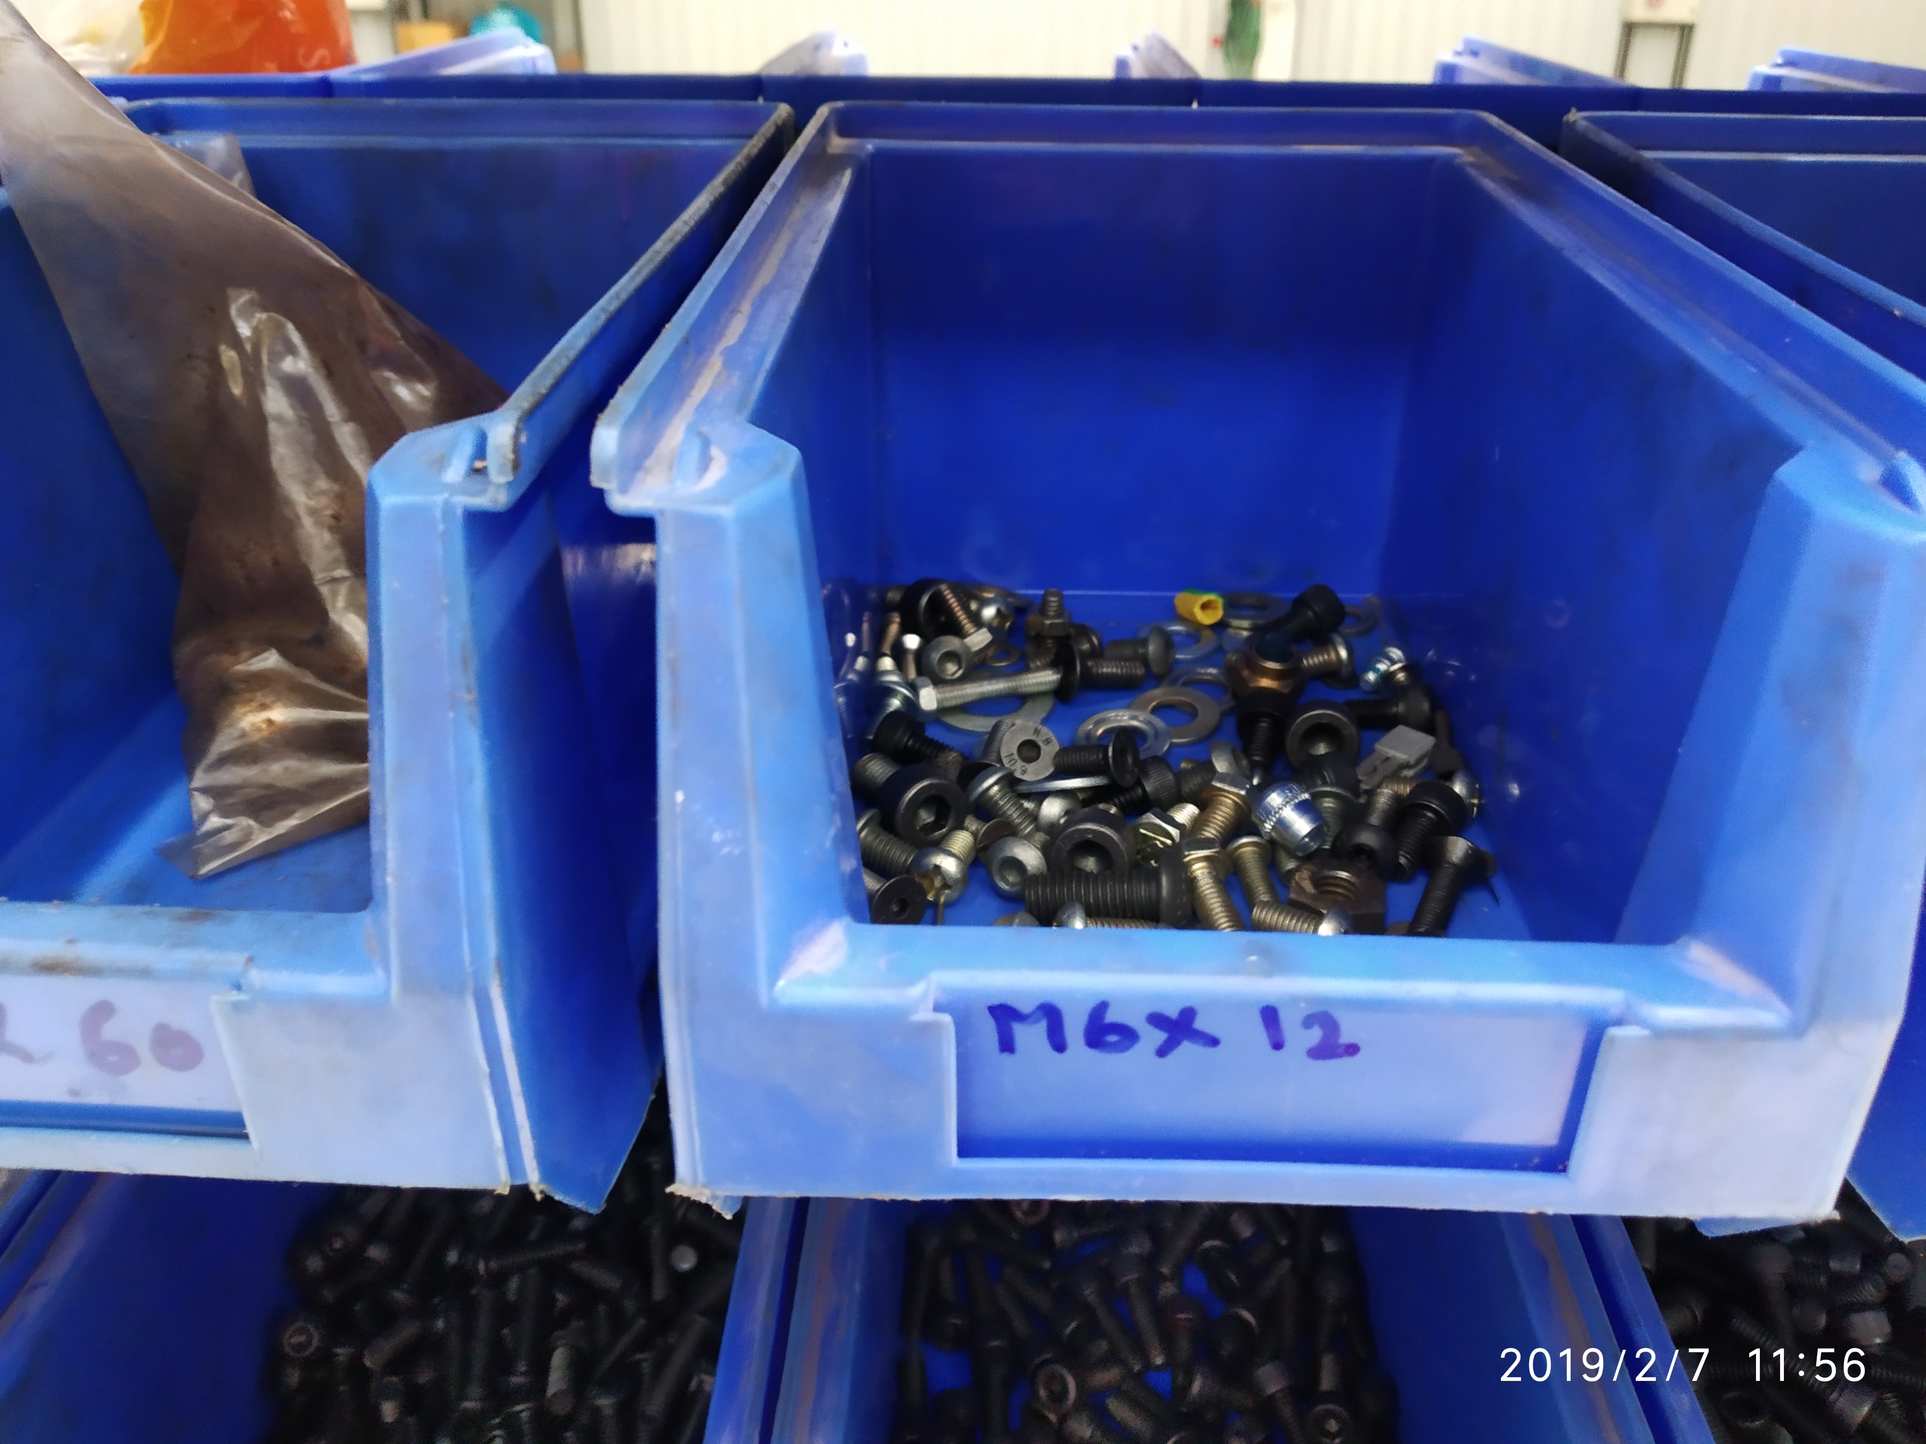
Sort

Slide 6
2.2
Second S: Set In Order
A place for everything and everything in its place.

Slide 7
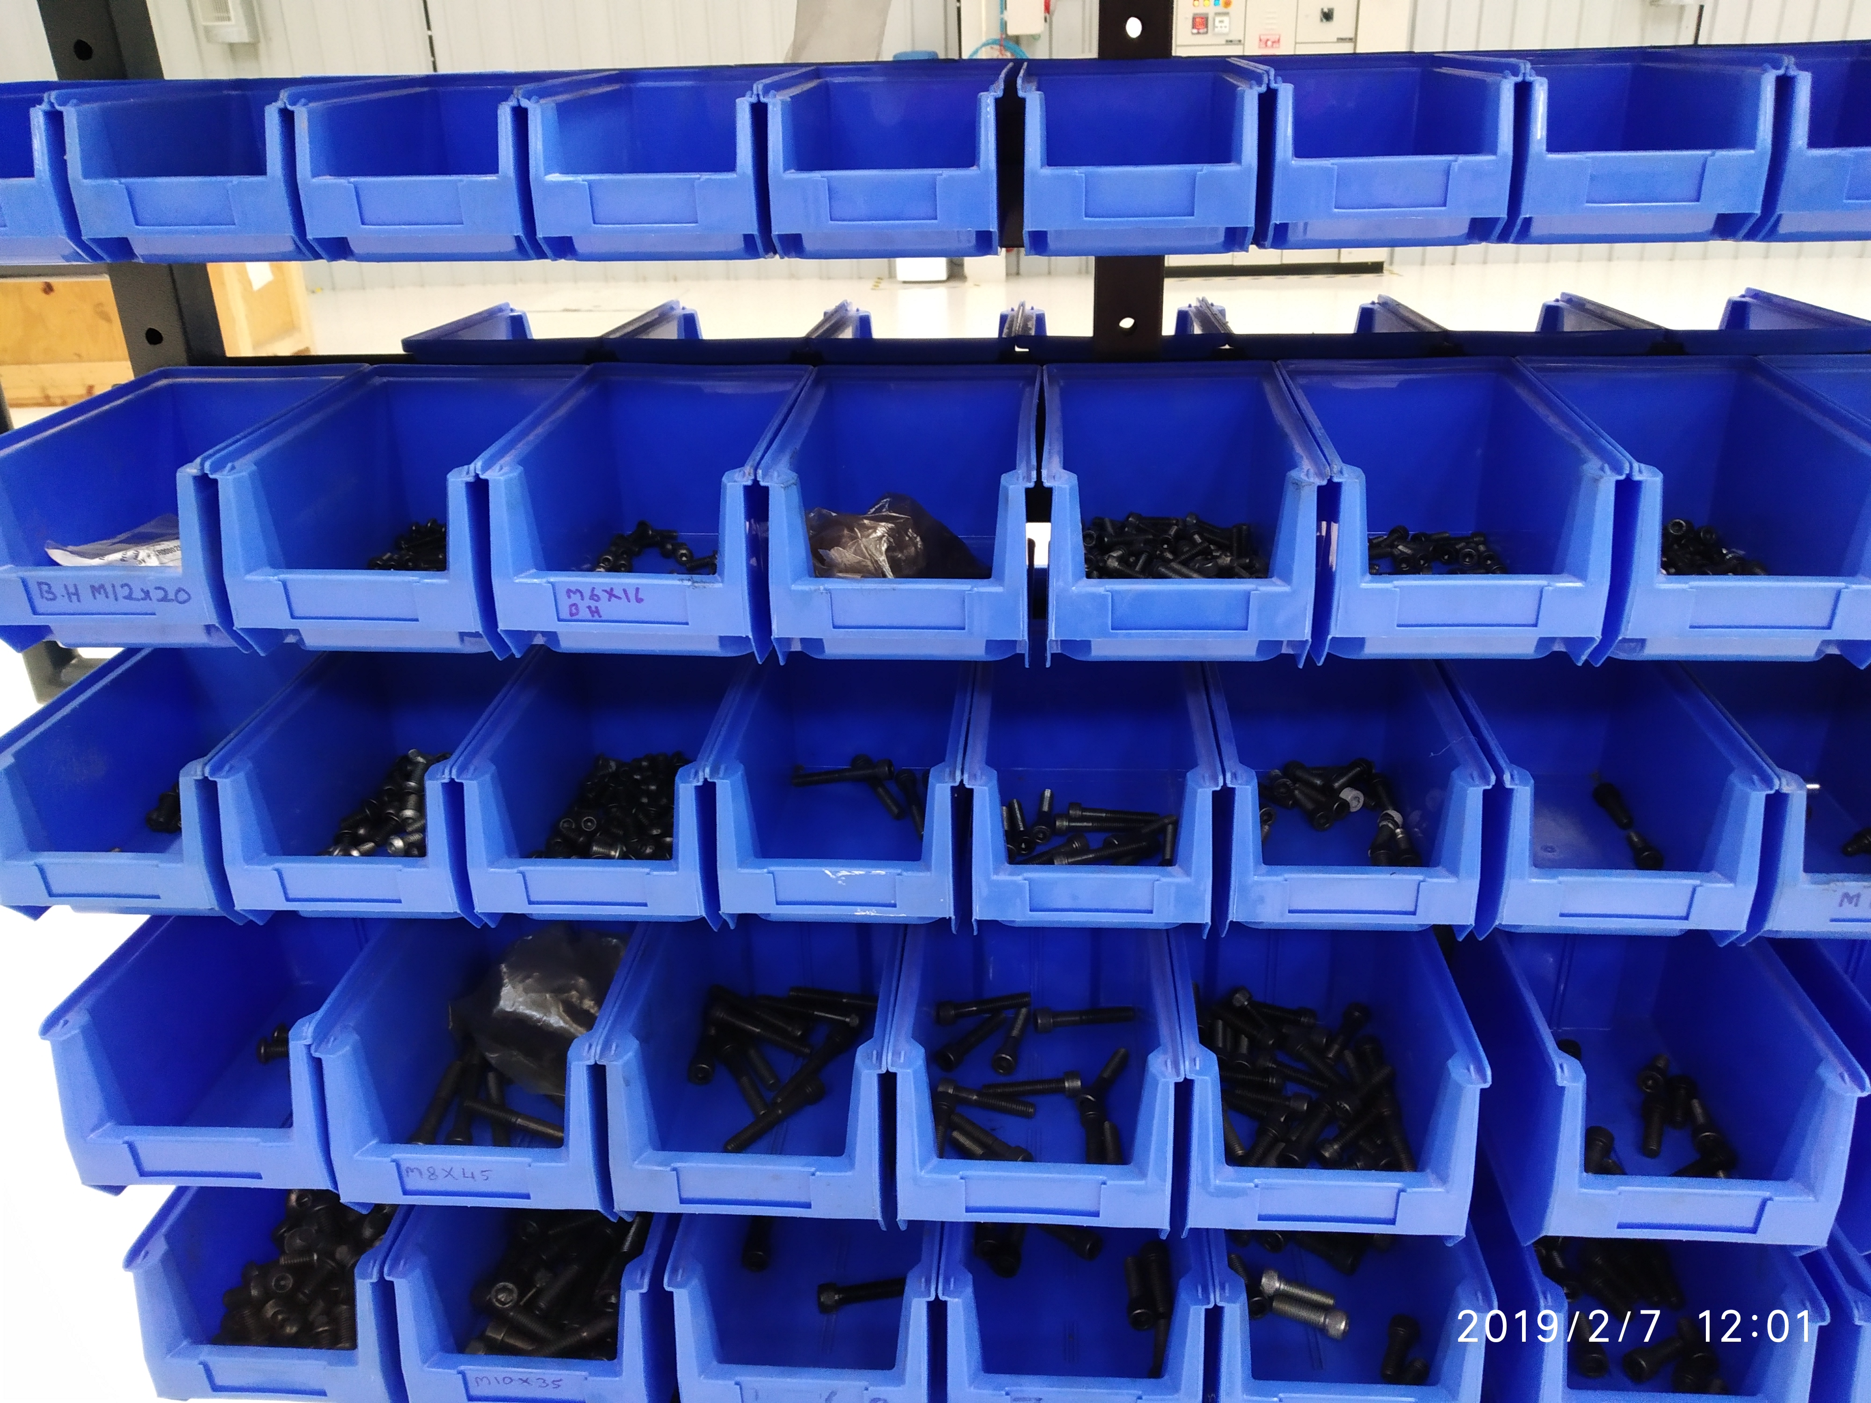
Set in Order

Slide 8
Third S: Shine
Cleaning and Inspecting the workplace.

Slide 9
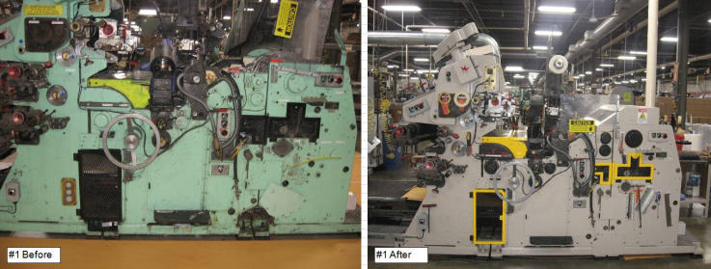
2.2

Slide 10
2.2
Fourth S: Standardize
Share established standards and make standards are clear

Slide 11
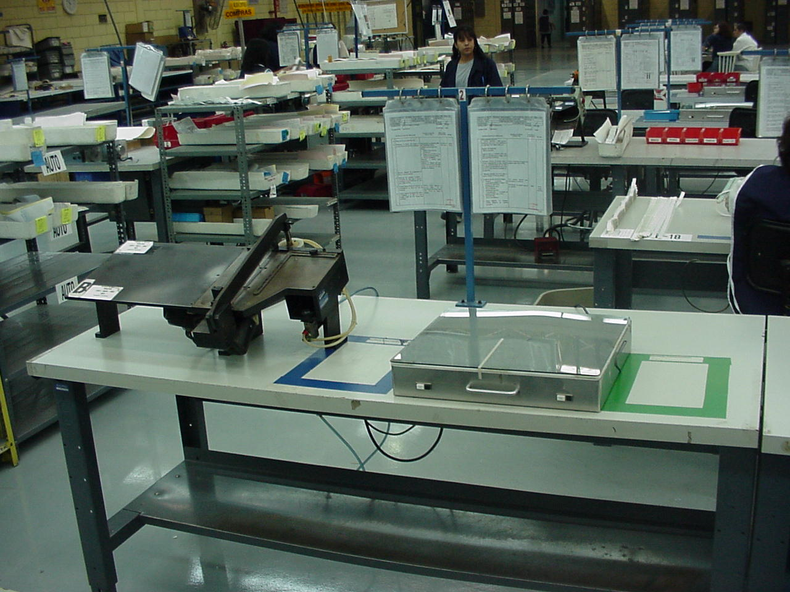
2.2

Slide 12
2.2
Fifth S: Sustain
Practicing and repeating this discipline until
it becomes a way of life.

Slide 13
+ 1S: Safety
Ensuring that Safety in inbuilt in any workplace

Slide 14
Imagine the following situation

Slide 15


Slide 16
5S+1 Numbers game.
To illustrate the impact that 5S+1 can have on productivity and quality, we will use the following exercise.

Slide 17
48
30
87
33
45
72
3
69
27
51
21
57
24
18
75
9
6
78
54
60
63
36
12
15
42
81
39
66
84
90
2
68
77
80
53
74
86
62
29
65
5
20
41
23
56
32
44
35
89
83
8
50
47
11
26
17
38
14
59
71
64
49
31
61
34
28
54
40
16
7
52
10
58
76
22
88
73
1
85
4
43
37
82
13
25
19
67
79
46
70

Slide 18
Numbers from 1 to 49
2
4
7
8
10
1
3
5
6
9
16
20
11
15
17
18
19
12
13
14
22
23
24
25
26
27
28
30
21
29
33
34
36
37
39
31
32
35
38
40
42
43
44
45
47
48
49
41
46

Slide 19
Thanks

